Slide 1
Cyber Crime in Bangladesh
Presented by:
Joy Pal
Id: 201002418
Sec: 203DACSE
Dept. of CSE
Green University

Slide 2
Contents
What is Cyber Crime?
Cyber Crime in Bangladesh
Cyber Law in Bangladesh
Recommendation
Conclusion

Slide 3
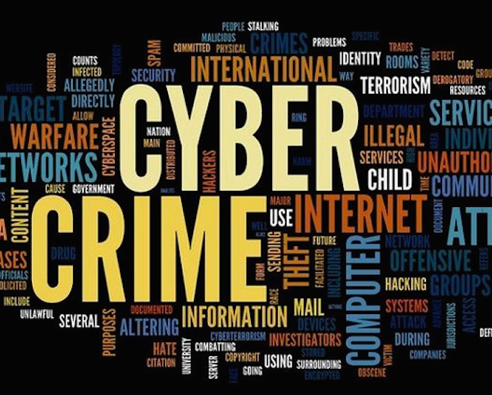
Cyber crime
Cyber crime is an activity done using computers and internet. We can say that it is an unlawful acts wherein the computer either a tool or target or both.
Types of cyber crime:
Hacking
Cyber-defamation
Cyber-extortion
E-mail bombing
Cyber-terrorism etc.

Slide 4
Cyber Crime in Bangladesh
Cyber and technology related crime is gradually increasing in Bangladesh. It has been that a glomming threat becomes visible in the area of information technology.
Bangladesh Bank Heist 2016.
Skype Scandal over International War Crime Tribunal.
Bangladesh Computer society website hacked in 2012.
Stealing the transaction report of Dhaka Stock Exchange.
Partho threatening prime minister Sheikh Hasina through email in 2004.

Slide 5
Cyber Law in Bangladesh
Bangladesh plans for strict Cyber-Crimes laws
The Information & communication Technology Act, 2006
The Digital Security Act, 2016

Slide 6
Recommendation
Enact cyber law in our country to prevent cyber criminals from committing cyber crime in Bangladesh.
Establish one digital forensic laboratory in our country for investigation and detection of cyber crime.
Develop a cyber crime legislation that will protect cyber security in Bangladesh.
Cyber police force is also needed in order to detect cyber criminals.
Providing training for a group of professionals and developing software.

Slide 7
Conclusion
Basically, no notable cyber crime has yet been committed in Bangladesh. The gradual dependence and extensive use of computer and information technology by the financial institutions like bank, insurance company and other non-government organizations increase the fear of commission of cyber crime here. Computer has been used as a tool of crime like making forged certificates and documents for a number of years in Bangladesh though the incident of targeting computer or computer is very unusual.

